Slide 1
SIMPATHY Economic Analysis Tool
Nils Michael
Alpana Mair

Slide 2
Background
Provides a high-level analysis of economic costs and benefits of polypharmacy reviews
Basis is Scottish Polypharmacy Model, but facility to apply EU28 population data and input own data for key variables
Key results are:
  Avoided cost of net drug reduction
  Avoided hospital admissions associated with Adverse Drug Reactions (ADR)
  Set against (staff) cost of implementing reviews
Notes:
Speaking notes
Analysis is top down, select population, apply model to total population
Scottish poly model developed for Guidance in 2013 and 2015
Being further developed in 2017 for Scotland
Avoided cost of net drug reduction can be cash releasing if previous baseline expenditure was factored into budget
Avoided hospital admissions and bed days are preventative and capacity release, non-cash releasing
Staff time, and cost equivalent, depend on local adaptation, either included in current workload or additional

Slide 3
Key products available on www.simpathy.eu
Economic Analysis tool (Excel based)
User guide (pdf), incl.
  Detailed explanation of the tool
  Model and methodology
  Case studies for Scotland & Northern Ireland
  Simulation results
  Literature review of associated avoidable Adverse Drug Reactions (ADRs)
Hand-out containing Consortium country demonstrations
Notes:
Speaking notes
Simulation work done in collaboration with partners from Germany
Key literature is Pirmohammed et al (2004) for ADR
Posters demonstrate use of tool, by applying the population data for the consortium countries to Scottish data for key variables. In reality there will be variation in local cost, time for review, etc

Slide 4
User Interface
Country and population data
Risk stratification
Option to add local data
Review setup, incl.
Staff cost
Charge per review
Estimated DDD started/ stopped
Choice variables, incl.
Cost of DDD
Admission rates
Bed day cost
Notes:
Speaking notes
For each step, can either choose Scottish data if local data not available, or can input local data
Can also use regional population data (e.g. population served by a hospital) instead of country level data.

Slide 5
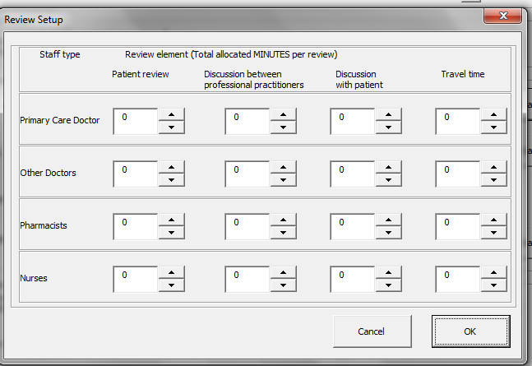
Inputting local data
Example: minutes per review by staff type and activity
Notes:
Speaking notes
In this example, if want to change the minutes spent by different staff types involved in reviews, can adjust this for the key activities and broad staff types.
Can also change average annual income for staff type.

Slide 6
Overview of result outputs – Example Scotland
Notes:
Speaking notes

Slide 7
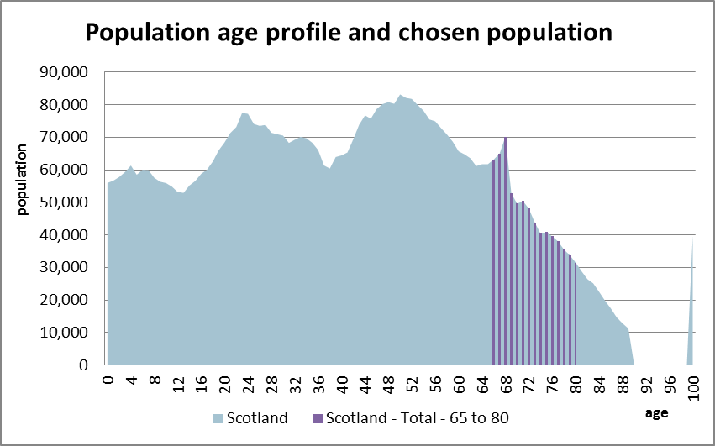
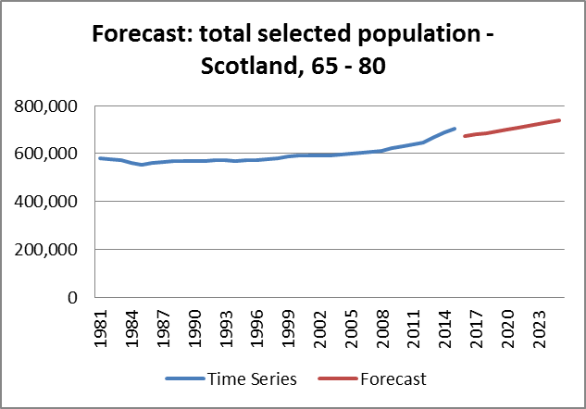
Population
Activity is driven by the selected population for whom reviews are intended to be carried out.
Tool also provides forecast of selected population group to 2030.
Notes:
Speaking notes
In the Scottish example, there is a risk stratification tool, SPARRA, estimating the number of people at risk of admission/ readmission, with a certain number of prescribed BNF categories
The tool also forecasts what the selected population (here, all male and female for Scotland, aged 65 to 80) will be in 2030 using simple exponential extrapolation.

Slide 8
Time and cost implications of reviews
Costs of reviews are based on the resource (staff) cost of carrying out a review, net of any potential review charge.
Notes:
Speaking notes
Tool translates the time spent per review by different clinician types and the annual wages into the cost per review
Option to subtract a charge if charge made per review. No charge in Scotland.

Slide 9
Avoided drug and bed day costs
The direct potential financial benefit of reviews will consist of the net reduction in drugs prescribed, and associated expenditure.
Potential indirect benefits (non-cash releasing) centre around:
Potentially avoided ADRs
Preventable hospital admissions associated with these ADRs
Associated number of hospital bed days avoided.
Notes:
Speaking notes
Drugs saved are DDD stopped minus DDD started (per review per annum) based on evidence from Scottish pilot studies
Number of reviews linked to ADR via Pirmohamed, also option to adjust the proportion of achieved avoided ADRs through poly reviews to make estimates more conservative.

Slide 10
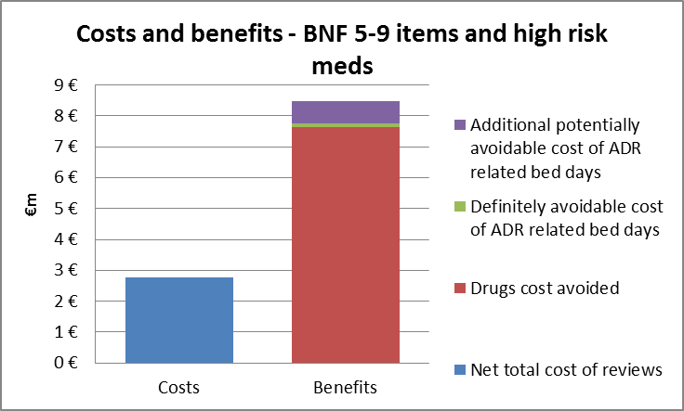
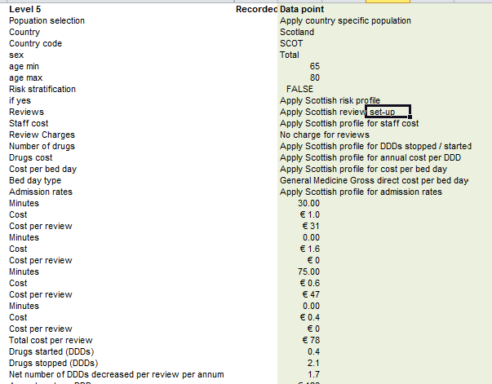
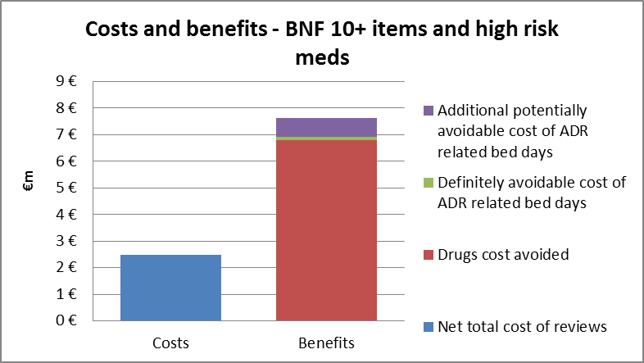
Additional outputs
Graphical representation
‘Snapshot’ Data collection
Notes:
A suite of charts to display the results for different risk groups
Can click an extra button to record the results for a set combination of variables (and extract from tool), to compare and contrast different combinations of variables (e.g. set time per review to different minutes per staff to see difference in overall cost)

